Slide 1
Microsoft Azure AI Fundamentals: Generative AI
Notes:
This content is meant to be taught in companion to: Microsoft Azure AI Fundamentals: Generative AI - Training | Microsoft Learn

Slide 2
Agenda
Fundamentals of Generative AI
Fundamentals of Azure OpenAI Service
Explore responsible Generative AI
Notes:
Estimated timing:
- Fundamentals of generative AI: 30 minutes
- Lab: Explore Bing Copilot: 10 minutes
- Fundamentals of Azure OpenAI Service: 30 minutes
- Explore responsible Generative AI: 10 minutes

Slide 3
Learning Objectives
After completing this module, you will be able to:
1
Describe generative AI.
2
Describe the capabilities of large language models.
3
Understand how to use Azure OpenAI to create generative AI solutions.

Slide 4
Fundamentals of Generative AI
Notes:
https://learn.microsoft.com/training/modules/fundamentals-generative-ai/
In this module you'll explore the way in which large language models (LLMs) enable AI applications and services to generate original content based on natural language input. You’ll also learn how generative AI enables the creation of AI-powered copilots that can assist humans in creative tasks.
By the end of this section, you'll be able to:
Understand generative AI's place in the development of artificial intelligence
Understand large language models and their role in intelligent applications
Describe how Azure OpenAI supports intelligent application creation
Describe examples of copilots and good prompts

Slide 5
What is generative AI?
AI: imitates human behavior by using machine learning to interact with the environment and execute tasks without explicit directions on what to output.
Generative AI: creates original content, such as generative AI that has been built into chat applications. Generative AI applications take in natural language input, and return appropriate responses in a variety of formats:
Natural language generation
Image generation
Code generation
Notes:
One popular example of such an application is ChatGPT, a chatbot created by OpenAI, an AI research company that partners closely with Microsoft.
Natural language generation
To generate a natural language response, you might submit a request such as "Give me three ideas for a healthy breakfast including peppers."
Image generation
Some generative AI applications can interpret a natural language request and generate an appropriate image. For example, you might submit a request like "Create an image of an elephant eating a burger".
Code generation
Some generative AI applications are designed to help software developers write code. For example, you could submit a request like "Show me how to code a game of tic-tac-toe with Python“.

Slide 6
Large language models
Generative AI applications are powered by large language models (LLMs), which are a specialized type of machine learning model that you can use to perform natural language processing (NLP) tasks, including:
Determining sentiment or otherwise classifying natural language text.
Summarizing text.
Comparing multiple text sources for semantic similarity.
Generating new natural language.
Notes:
While the mathematical principles behind these LLMs can be complex, a basic understanding of the architecture used to implement them can help you gain a conceptual understanding of how they work.

Slide 7
Large language models - transformer model
Transformer model architecture consists of two main components, or blocks:
An encoder block that creates semantic representations of the training vocabulary.
A decoder block that generates new language sequences.
Text is tokenized so each word or phrase is represented by a unique numeric token
The tokens are assigned embeddings – vector values with multiple dimensions
Attention layers examine each token in turn and determine embedding values that reflect semantic relationships between tokens
In the decoder, these relationships are used to predict the most probable sequence of tokens
Features (enriched embeddings)
Output
Feed Forward
Attention
Feed Forward
Feed Forward
Attention
Decoder
Encoder
Attention
Feed Forward
Feed Forward
Attention
Attention
Positional Encoding
Positional Encoding
Embedding
Input
Tokenization
Input text
Notes:
Don’t dwell too much on the details of the model architecture. The key points are on the slide. The next few slides will explore some of the main concepts in detail.
Machine learning models for natural language processing have evolved over many years. Today's cutting-edge large language models are based on the transformer architecture, which builds on and extends some techniques that have been proven successful in modeling vocabularies to support NLP tasks - and in particular in generating language. Transformer models are trained with large volumes of text, enabling them to represent the semantic relationships between words and use those relationships to determine probable sequences of text that make sense. Transformer models with a large enough vocabulary are capable of generating language responses that are tough to distinguish from human responses.
In practice, the specific implementations of the architecture vary – for example, the Bidirectional Encoder Representations from Transformers (BERT) model developed by Google to support their search engine uses only the encoder block, while the Generative Pretrained Transformer (GPT) model developed by OpenAI uses only the decoder block.
While a complete explanation of every aspect of transformer models is beyond the scope of this module, an explanation of some of the key elements in a transformer can help you get a sense for how they support generative AI.

Slide 8
Large language models – tokenization
Step one: tokenization
The first step in training a transformer model is to decompose the training text into tokens.
Example sentence: I heard a dog bark loudly at a cat.
"I"=1
"heard"=2
"a"=3
"dog"=4
"bark"=5
"loudly"=6
"at"=7
"cat"=8
The sentence is now represented with the tokens: [1 2 3 4 5 6 7 3 8].
Note "a" is tokenized as 3 only once.
Similarly, the sentence "I heard a cat" could be represented with the tokens [1 2 3 8].
Notes:
The first step in training a transformer model is to decompose the training text into tokens - in other words, identify each unique text value.
For the sake of simplicity, you can think of each distinct word in the training text as a token. Though in reality, tokens can be generated for partial words, or combinations of words and punctuation.
As you continue to train the model, each new token in the training text is added to the vocabulary with appropriate token IDs:
“I” is 1
“heard” is 2
“a” is 3
“dog” is 4
With a sufficiently large set of training text, a vocabulary of many thousands of tokens could be compiled.

Slide 9
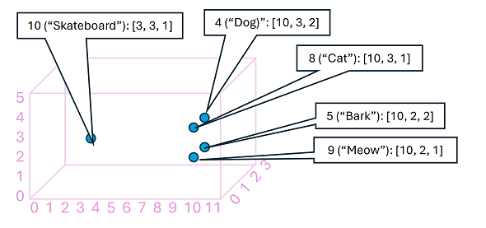
Large language models – embeddings
Step two: embeddings
The relationships between tokens are captured as vectors, known as embeddings.
Token | Word | Embedding
10 | Skateboard | [3, 3, 1]
4 | Dog | [10,3,2]
8 | Cat | [10,3,1]
5 | Bark | [10,2,2]
9 | Meow | [10,2,1]
Notes:
While it may be convenient to represent tokens as simple IDs - essentially creating an index for all the words in the vocabulary, they don't tell us anything about the meaning of the words, or the relationships between them. To create a vocabulary that encapsulates semantic relationships between the tokens, we define contextual vectors, known as embeddings, for them. Vectors are multi-valued numeric representations of information, for example [10, 3, 1] in which each numeric element represents a particular attribute of the information. For language tokens, each element of a token's vector represents some semantic attribute of the token. The specific categories for the elements of the vectors in a language model are determined during training based on how commonly words are used together or in similar contexts.
It can be useful to think of the elements in a token embedding vector as coordinates in multidimensional space, so that each token occupies a specific "location." The closer tokens are to one another along a particular dimension, the more semantically related they are. In other words, related words are grouped closer together.
The locations of the tokens in the embeddings space include some information about how closely the tokens are related to one another.
In the previous example, we looked at one sentence. Now imagine the sentence is part of a whole book of text. We have tokenized all the text, and now we map the relationship between tokens based on what tokens they often appear next to.
For example, the token for "dog" is close to "cat" and also to "bark." The tokens for "cat" and "bark" are close to "meow." The token for "skateboard" is further away from the other tokens.
Note:
The previous example shows a simple example model in which each embedding has only three dimensions. Real language models have many more dimensions.
There are multiple ways you can calculate appropriate embeddings for a given set of tokens, including language modeling algorithms like Word2Vec or the encoder block in a transformer model.

Slide 10
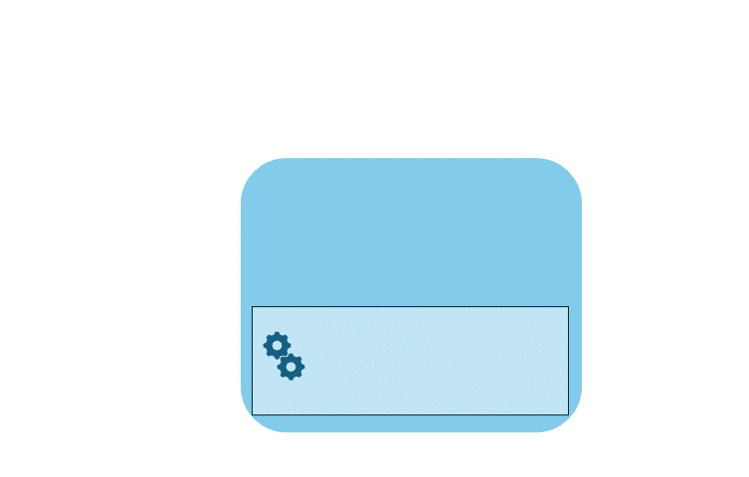
Large language models – attention
Step three: attention
Capture the strength of relationships between tokens using the attention technique.
Example:
Goal: predict token after “dog.”
Represent “I heard a dog” as vectors.
Assign “heard” and “dog” more weight.
Several possible tokens can come after dog.
The most probable token is added to the sequence, in this case “bark.”
Notes:
The encoder and decoder blocks in a transformer model include multiple layers that form the neural network for the model. We don't need to go into the details of all these layers, but it's useful to consider one of the types of layers that is used in both blocks: attention layers. Attention is a technique used to examine a sequence of text tokens and try to quantify the strength of the relationships between them. In particular, self-attention involves considering how other tokens around one particular token influence that token's meaning.
In an encoder block, attention is used to examine each token in context, and determine an appropriate encoding for its vector embedding. The vector values are based on the relationship between the token and other tokens with which it frequently appears. This contextualized approach means that the same word might have multiple embeddings depending on the context in which it's used - for example "the bark of a tree" means something different to "I heard a dog bark.“
In a decoder block, attention layers are used to predict the next token in a sequence. For each token generated, the model has an attention layer that takes into account the sequence of tokens up to that point. The model considers which of the tokens are the most influential when considering what the next token should be.
Remember that the attention layer is working with numeric vector representations of the tokens, not the actual text. In a decoder, the process starts with a sequence of token embeddings representing the text to be completed.
During training, the goal is to predict the vector for the final token in the sequence based on the preceding tokens. The attention layer assigns a numeric weight to each token in the sequence so far. It uses that value to perform a calculation on the weighted vectors that produces an attention score that can be used to calculate a possible vector for the next token. In practice, a technique called multi-head attention uses different elements of the embeddings to calculate multiple attention scores. A neural network is then used to evaluate all possible tokens to determine the most probable token with which to continue the sequence. The process continues iteratively for each token in the sequence, with the output sequence so far being used regressively as the input for the next iteration – essentially building the output one token at a time.
The following animation shows a simplified representation of how this works – in reality, the calculations performed by the attention layer are more complex; but the principles can be simplified as shown:
A sequence of token embeddings is fed into the attention layer. Each token is represented as a vector of numeric values.
The goal in a decoder is to predict the next token in the sequence, which will also be a vector that aligns to an embedding in the model’s vocabulary.
The attention layer evaluates the sequence so far and assigns weights to each token to represent their relative influence on the next token.
The weights can be used to compute a new vector for the next token with an attention score. Multi-head attention uses different elements in the embeddings to calculate multiple alternative tokens.
A fully connected neural network uses the scores in the calculated vectors to predict the most probable token from the entire vocabulary.
The predicted output is appended to the sequence so far, which is used as the input for the next iteration.
During training, the actual sequence of tokens is known – we just mask the ones that come later in the sequence than the token position currently being considered. As in any neural network, the predicted value for the token vector is compared to the actual value of the next vector in the sequence, and the loss is calculated. The weights are then incrementally adjusted to reduce the loss and improve the model. When used for inferencing (predicting a new sequence of tokens), the trained attention layer applies weights that predict the most probable token in the model’s vocabulary that is semantically aligned to the sequence so far.
What all of this means, is that a transformer model such as GPT-4 (the model behind ChatGPT and Bing) is designed to take in a text input (called a prompt) and generate a syntactically correct output (called a completion). In effect, the “magic” of the model is that it has the ability to string a coherent sentence together. This ability doesn't imply any “knowledge” or “intelligence” on the part of the model; just a large vocabulary and the ability to generate meaningful sequences of words. What makes a large language model like GPT-4 so powerful however, is the sheer volume of data with which it has been trained (public and licensed data from the Internet) and the complexity of the network. This enables the model to generate completions that are based on the relationships between words in the vocabulary on which the model was trained; often generating output that is indistinguishable from a human response to the same prompt.
A diagram that shows how the attention technique helps the large language model identify the next word in the sequence. The image shows words and their positional encoding layer coordinates.

Slide 11
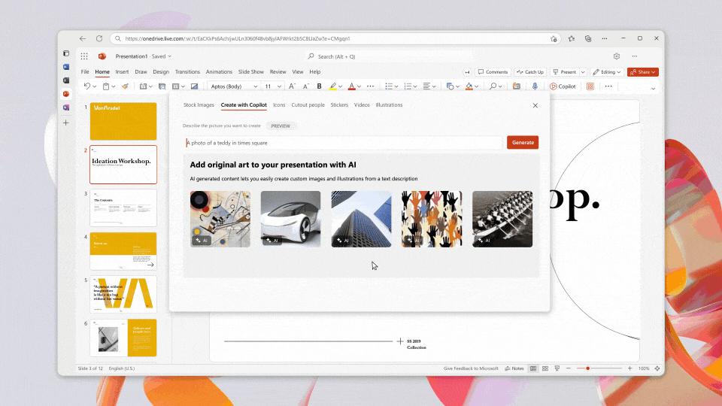
Copilots
Copilots are often integrated into other applications and provide a way for users to get help with common tasks from a generative AI model.
Developers can build copilots that submit prompts to large language models and generate content for use in applications.
Business users can use copilots to boost their productivity and creativity with AI-generated content.
Notes:
Copilots are based on a common architecture, so developers can build custom copilots for various business-specific applications and services.
You may see copilots appear within the products that you already use, for example, as a chat screen feature that opens up next to your file. These copilots use the content that is created or searched for in the product as specific information for its results.
Microsoft 365 copilot works alongside you in productivity and communication apps such as PowerPoint and Outlook, assisting you in creating effective documents, spreadsheets, presentations, emails, and other ways.

Slide 12
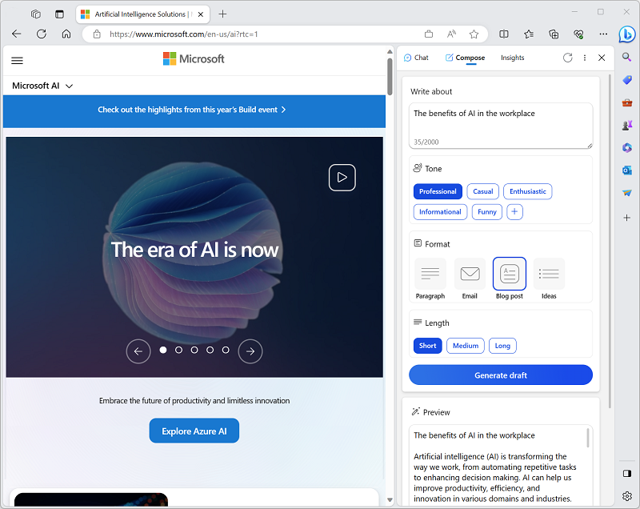
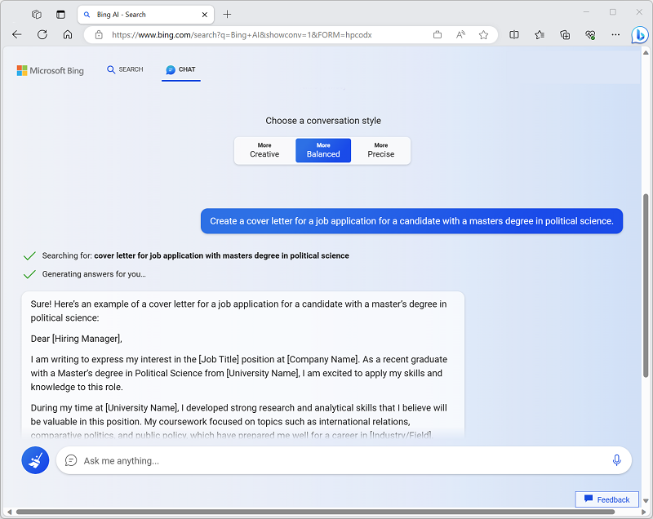
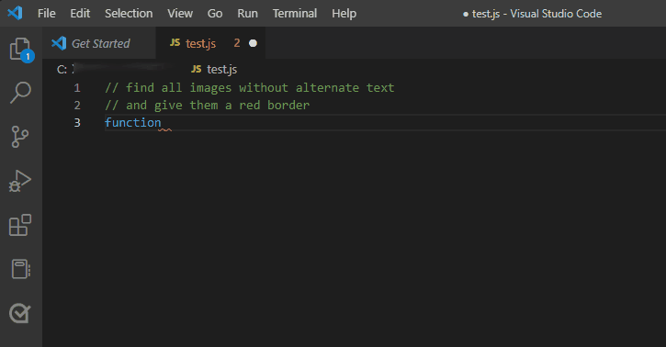
What are copilots?
Other examples of copilots
Microsoft Edge browser copilot
Microsoft Bing copilot
GitHub copilot
And many more!
Notes:
Microsoft has already added copilots to commonly used applications.
In the Microsoft Edge browser, a copilot enables you to summarize the page you’re currently browsing or to generate new content.
The Microsoft Bing search engine provides a copilot to help when browsing or searching the Internet by generating natural language answers to questions based on context rather than just search results of indexed pages.
GitHub copilot provides support to software developers, helping them write, document, and test code.

Slide 13
Improve generative AI responses with prompt engineering
The term prompt engineering describes the process of prompt improvement.
Both developers who design applications and consumers who use applications can improve the quality of responses from generative AI by using direct language, system messages, examples, and/or grounding data.
 | Description | Example
Direct language | You can get the most useful completions by being explicit about the kind of response you want. | “Create a list of 10 things to do in Edinburgh during August”.
System messages | Describe how the chat should act. | "You're a helpful assistant that responds in a cheerful, friendly manner“.
Providing examples | LLMs generally support zero-shot learning in which responses can be generated without prior examples. However, you can also provide a few example responses, known as few-shot learning. | “Visit the castle in the morning before the crowds arrive”.
Grounding data | You can include grounding data to provide context. | Including email text with the prompt “Summarize my email”.
Notes:
The quality of responses that a generative AI application returns not only depends on the model itself, but on the types of prompts it's given.
Prompts are ways we tell an application what we want it to do. An engineer can add instructions for the program with prompts. For example, developers may build a generative AI application for teachers to create multiple-choice questions related to text students read. During the development of the application, developers can add other rules for what the program should do with the prompts it receives.
Writing good prompts
You can achieve better results when you submit clear, specific prompts.
System messages
The message sets the context for the model by describing expectations and constraints, for example, "You're a helpful assistant that responds in a cheerful, friendly manner". These system messages determine constraints and styles for the model's responses.
Providing examples
However, you can also provide one-shot learning prompts that include one, or a few, examples of the output you require such as, “Visit the castle in the morning before the crowds arrive”. The model can then generate further responses in the same style as the examples provided in the prompt. Show the chat what responses you want. It will try to mimic any responses you add.
Grounding data
You can use grounding data as a prompt engineering technique to gain many of the benefits of fine-tuning without having to train a custom model.
To apply this technique, include contextual data in the prompt so that the model can use it to generate an appropriate output. For example, suppose you want to use an LLM to generate a summary of an email. You can include the email text in the prompt with an instruction to summarize it.

Slide 14

Exercise: Explore generative AI with Bing Chat copilot
Use the hosted environment and Azure credentials provided for this exercise.
In this exercise, you will use Bing Chat copilot to explore generative AI.
The instructions are also available on Learn: https://aka.ms/ai900-bing-copilot
Notes:
Note:
To complete this exercise, you will need a personal Microsoft account. You can create one for free at https://signup.live.com/.
Point out that exercises are also available on Microsoft Learn for all of the other tasks demonstrated and discussed in this PowerPoint. https://microsoftlearning.github.io/mslearn-ai-fundamentals.

Slide 15
Fundamentals of Azure OpenAI Service
Notes:
https://learn.microsoft.com/en-us/training/modules/explore-azure-openai/
In other words, we’re going to…
Describe Azure OpenAI workloads and access the Azure OpenAI Service
Understand generative AI models
Understand Azure OpenAI's language, code, and image capabilities

Slide 16
What is Azure OpenAI?
Azure OpenAI service is Microsoft's cloud solution for deploying, customizing, and hosting large language models.
Azure OpenAI service consists of:
Pre-trained generative AI models.
Customization capabilities.
Built-in tools to detect and mitigate harmful use cases so users can implement AI responsibly.
Enterprise-grade security with role-based access control (RBAC) and private networks.
You can use several methods to develop Azure OpenAI solutions: Azure AI Studio, REST API, supported SDKs, and Azure CLI.
Notes:
Azure OpenAI Service brings together the best of OpenAI's cutting edge models and APIs with the security and scalability of the Azure cloud platform. Microsoft's partnership with OpenAI enables Azure OpenAI users to access the latest language model innovations.
Azure AI Studio
Developers can work with these models in Azure AI Studio, a web-based environment where AI professionals can deploy, test, and manage LLMs that support generative AI app development on Azure.
Within Azure AI Studio, you can deploy large language models, provide few-shot examples, and test them in Azure OpenAI Studio's Chat playground.

Slide 17
What models does Azure OpenAI support?
Azure OpenAI supports many LLMs: | Description
GPT-4 | A set of models that improve on GPT-3.5 and can understand as well as generate natural language and code.
GPT-3.5 | A set of models that improve on GPT-3 and can understand as well as generate natural language and code.
Embeddings | A set of models that can convert text into numerical vector form to facilitate text similarity.
DALL-E (preview) | A series of models in preview that can generate original images from natural language.
Notes:
Azure OpenAI brings together the best of OpenAI's cutting edge models and APIs with the security and scalability of the Azure cloud platform. Microsoft's partnership with OpenAI enables Azure OpenAI users to access the latest language model innovations.
GPT-4 models are the latest generation of generative pretrained (GPT) models that can generate natural language and code completions based on natural language prompts. Access to GPT-4 models is currently restricted - for access, existing Azure OpenAI customers can apply by filling out this form.
GPT 3.5 models can generate natural language and code completions based on natural language prompts. In particular, GPT-35-turbo models are optimized for chat-based interactions and work well in most generative AI scenarios.
Embeddings models convert text into numeric vectors, and are useful in language analytics scenarios such as comparing text sources for similarities.
DALL-E models are used to generate images based on natural language prompts. Currently, DALL-E models are in preview. DALL-E models aren't listed in the Azure OpenAI Studio interface and don't need to be explicitly deployed.
Models differ by speed, cost, and how well they complete specific tasks. You can learn more about the differences and latest models offered in the Azure OpenAI Service documentation.

Slide 18
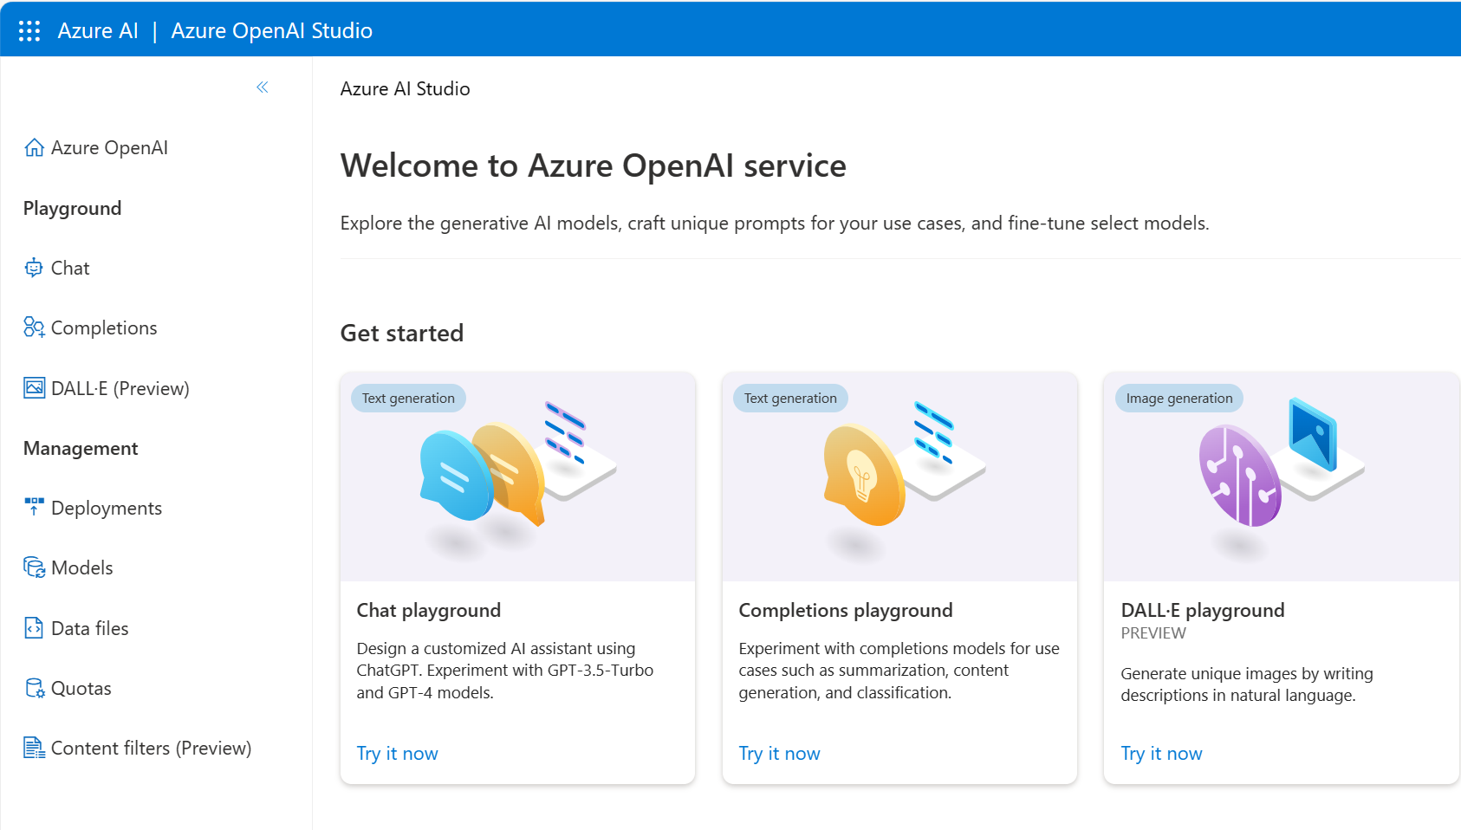
How to use Azure OpenAI
Azure OpenAI Studio:
Build and deploy AI models for software applications
Powered by generative AI models optimized for various tasks
Azure OpenAI models include: GPT-4, GPT-3.5, Embeddings and DALL-E models
Playgrounds:
Experiment with Azure OpenAI models without coding
Use the assistant setup to instruct the model about how it should behave
Notes:
Currently you need to apply for access to Azure OpenAI. Once granted access, you can use the service by creating an Azure OpenAI resource, like you would for other Azure services. Once the resource is created, you can use the service through REST APIs, Python SDK, or the web-based interface in the Azure OpenAI Studio.
Understanding how to utilize Azure OpenAI is key:
Azure OpenAI Studio is your space to construct and deploy AI models for software applications.
It leverages specific generative AI models tailored for various tasks.
Notable models include GPT-4, GPT-3.5, Embeddings models, and DALL-E models.
Playgrounds offer a code-free environment for experimentation.
In the Chat playground, you can define how the model behaves using the assistant setup.

Slide 19
Azure OpenAI's natural language capabilities
Generative pre-trained transformer (GPT) models are excellent at both understanding and creating natural language.
For example, given a prompt where the user types in text asking for a cooking recipe:
Here's an example of the Azure OpenAI generated response:
Write recipe instructions for a fruit pie based on these ingredients:
Strawberries
Blueberries
Flour
Eggs
Milk
Instructions:
1. Preheat your oven to 350 degrees Fahrenheit.
2. In a medium bowl, mix together 1 cup of flour and 1 egg until it forms a dough.
3. Grease a 9-inch pie dish with butter or non-stick cooking spray.
4. Roll out the dough and place it in the pie dish.
5. In a separate bowl, mix together 1 cup of strawberries, 1 cup of blueberries, and 1 cup of milk.
6. Pour the fruit mixture into the pie dish.
7. Bake
Notes:
Azure OpenAI's models process natural language and generate responses.
Application to New Use Cases
ChatGPT is an example.
Combines front-end UI and back-end generative AI model.
Available as a building block in OpenAI and Azure OpenAI APIs.
Developers customize for specific use cases.

Slide 20
Azure OpenAI’s code generation capabilities
GPT models translate natural language or code snippets into code.
Code generation goes beyond just writing code from natural language prompts. Given the following code, it can generate unit tests as shown on the right:
Python
# Python 3
def mult_numbers(a, b):
return a * b
# Unit test
def test_mult_numbers():
assert mult_numbers(3, 4) == 12
assert mult_numbers(0, 10) == 0
assert mult_numbers(4, 0) == 0
# Unit test
def test_mult_numbers_negative():
assert mult_numbers(-1, 10) == -10
assert mult_numbers(10, -1) == -10
Python
# Python 3
def mult_numbers(a, b):
return a * b
# Unit test
def
Notes:
GitHub Copilot
OpenAI partnered with GitHub to create GitHub Copilot, which they call an AI pair programmer. GitHub Copilot integrates the power of OpenAI Codex into a plugin for developer environments like Visual Studio Code.
Once the plugin is installed and enabled, you can start writing your code, and GitHub Copilot starts automatically suggesting the remainder of the function based on code comments or the function name.
GitHub Copilot offers multiple suggestions for code completion, which you can tab through using keyboard shortcuts. When given informative code comments, it can even suggest a function name along with the complete function code.

Slide 21

Azure OpenAI's image generation capabilities
Generative AI models can edit and create images. The model that works with images is called DALL-E, which supports image creation, image editing and image variations creation.
Image generation: With DALL-E, you can even request an image in a particular style. Styles can be used for edits and variations as well.
Editing an image: DALL-E can edit the image as requested by changing its style, adding or removing items, or generating new content to add.
Image variations: Image variations can be created by providing an image and specifying how many variations of the image you would like.
Prompt: Create four variations of an image of an elephant with a hamburger.
Notes:
For example, given the prompt "an elephant standing with a burger on top, style digital art", as shown in the above figure, the model generates digital art images depicting exactly what is asked for.

Slide 22
Demo: Explore Azure OpenAI Service
Follow along on the exercise page at: https://aka.ms/ai900-azure-openai
In this demo, you’ll see Azure OpenAI’s capabilities in action.
Notes:
Instructors: we recommend you complete the exercise ahead of time. During class, you can demonstrate the service.
https://microsoftlearning.github.io/mslearn-ai-fundamentals/Instructions/Labs/13-azure-openai.html
Instructors: As access to Azure OpenAI service is by application, you can demo the lab in the link above. If you do not have access, you will also need to sign up for Azure OpenAI access (including text and code models as well as DALL-E image generation).

Slide 23
Responsible generative AI
Notes:
https://learn.microsoft.com/training/modules/responsible-generative-ai/
Let’s get started with the Learning Objective: Explore Responsible Generative AI
The learning objective explores a set of guidelines for responsible generative AI that has been defined by experts at Microsoft. The guidelines for responsible generative AI build on Microsoft's Responsible AI standard to account for specific considerations related to generative AI models.

Slide 24
Plan a responsible generative AI solution
Four stage process to develop and implement a plan for responsible AI are:
Identify
Measure
Mitigate
Operate
Potential harms that are relevant to your planned solution.
The presence of these harms in the outputs generated by your solution.
The harms at multiple layers in your solution to minimize their presence and impact.
The solution responsibly by defining and following a deployment and operational readiness plan.
Notes:
The Microsoft guidance for responsible generative AI is designed to be practical and actionable. It defines a four stage process to develop and implement a plan for responsible AI when using generative models. The four stages in the process are:
Identify potential harms that are relevant to your planned solution.
Measure the presence of these harms in the outputs generated by your solution.
Mitigate the harms at multiple layers in your solution to minimize their presence and impact, and ensure transparent communication about potential risks to users.
Operate the solution responsibly by defining and following a deployment and operational readiness plan.
These stages correspond closely to the functions in the NIST AI Risk Management Framework.
The remainder of this learning objective discusses each of these stages in detail, providing suggestions for actions you can take to implement a successful and responsible generative AI solution.

Slide 25
Demo: Explore content filters in Azure OpenAI
Follow along on the exercise page at: https://aka.ms/ai900-content-filters
In this demo, you’ll see Azure OpenAI’s content filters in action.
Notes:
Instructors: we recommend you complete the exercise ahead of time. During class, you can demonstrate the service.
https://microsoftlearning.github.io/mslearn-ai-fundamentals/Instructions/Labs/14-azure-openai-content-filters.html
Instructors: As access to Azure OpenAI service is by application, you can demo the lab in the link above. If you do not have access, you will also need to sign up for Azure OpenAI access (including text and code models as well as DALL-E image generation).

Slide 26
Knowledge check
Which of the following would you classify as Generative AI?
Transcribing speech into text
Writing a new report
Extracting information from a receipt
How can you demonstrate the generative AI capabilities of Azure OpenAI without writing code?
OpenAI Studio
Azure portal
REST API
You are designing an application using Azure OpenAI services. What steps should you take to ensure responsible use of AI in your application?
Nothing is required. Responsible AI is built into the model
Create a plan that includes training potential users about responsible AI
Create a plan that includes the following steps: Plan, Measure, Mitigate, and Operate
Notes:
Allow students a few minutes to think about the questions, and then reveal the correct answers.

Slide 27
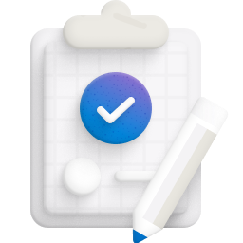
Summary
Fundamentals of generative AI
Understand generative AI's place in the development of artificial intelligence.
Understand large language models and their role in intelligent applications.
Describe how Azure OpenAI supports intelligent application creation.
Describe examples of copilots and good prompts.
Fundamentals of Azure OpenAI Service
Describe Azure OpenAI workloads and access the Azure OpenAI Service
Understand generative AI models
Understand Azure OpenAI's language, code, and image capabilities
Explore responsible generative AI
Understand the four stages for a responsible generative AI solution

Slide 28

References
Read more about:
Fundamentals of Generative AI
Fundamentals of Azure OpenAI Service
Fundamentals of Responsible Generative AI
Through the content on Learn: Microsoft Azure AI Fundamentals: Generative AI - Training | Microsoft Learn
Notes:
Encourage students to review the content on Learn for more information.

Slide 29
Closing slide

